Slide 1
讀書會_品質與統計手法案例分享 – Vivomove Sport 機芯原材驗證
DPQE
Ernest Fu
2022.02.25

Slide 2
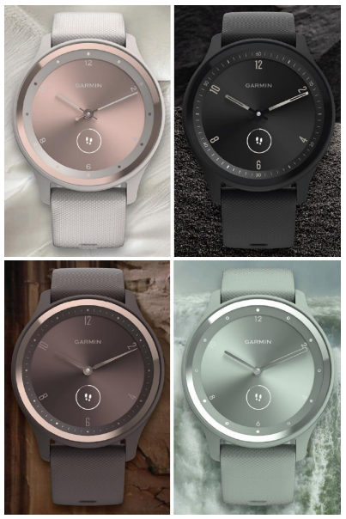
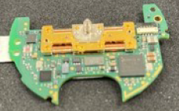
TABLE OF CONTENT
Problem Statement
MSA Preparation
Distribution & Cgk
F-TEST & T-TEST Validation
Notes:
問題說明
MSA前處理
運用統計手法進行確效驗證

Slide 3
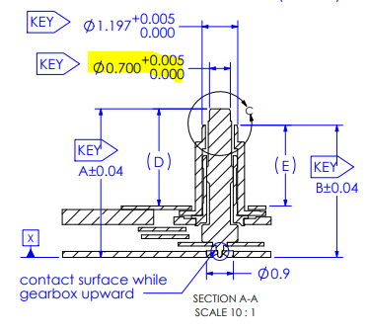
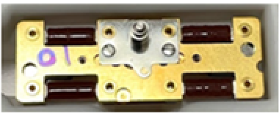
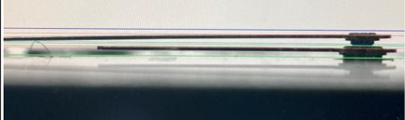
Problem Statement
Issue : No defect rate on supplier site is observed but Garmin is 12.5 % on the same Batch by IQC
Measurement Site | Defect Rate
Supplier | 0 %
Garmin | 12.5 %
Gearbox_MH (370-00043-00 )
Test Plan:
MSA
Check
Cgk
Check
F-Test / T-Test
Check
Notes:
因為有品質議題，DPQE 需要Align 量具和量測數據,進行MSA的確認

Slide 4
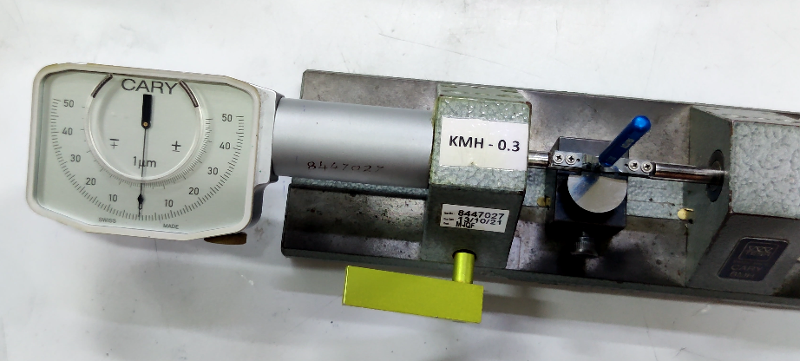
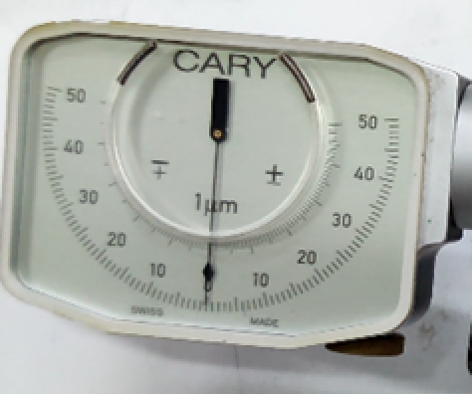
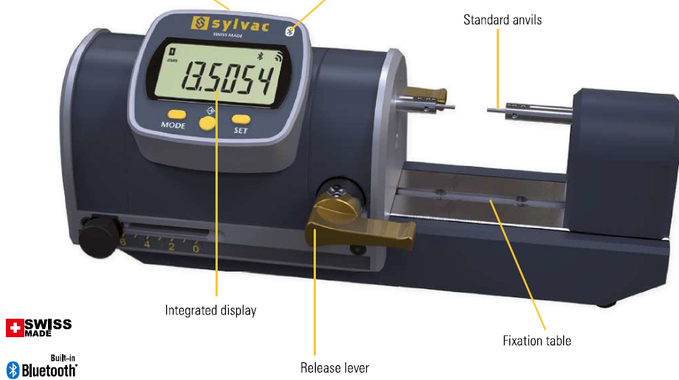
MSA Preparation
Supplier’s measurement equipment is not meet MSA rule.
Supplier’s Measurement Equipment
Garmin | Supplier
0.6994 | 0.701
0.7008 | 0.703
0.7000 | 0.702
0.7005 | 0.703
0.7021 | 0.704
0.7004 | 0.703
0.7003 | 0.702
0.6980 | 0.701
0.7000 | 0.703
0.7013 | 0.703
0.6987 | 0.702
0.7002 | 0.702
0.7003 | 0.703
0.7009 | 0.703
0.7009 | 0.704
0.7000 | 0.701
0.7028 | 0.704
0.7009 | 0.703
0.7006 | 0.702
0.6996 | 0.701
0.7018 | 0.703
0.7004 | 0.702
0.7009 | 0.702
0.7004 | 0.703
0.7023 | 0.703
0.701 | 0.702
0.7006 | 0.701
0.7004 | 0.702
0.7015 | 0.703
0.7014 | 0.702
0.7023 | 0.703
0.7002 | 0.703
Finding
Garmin’s Measurement Equipment
Inaccuracy
(Spec.: 0.700~0.705 mm)
Test Plan:
MSA
Check
Cgk
Check
F-Test / T-Test
Check
Notes:
Finding、Cgk 前期處理時發現供應商不符合MSA原則，量測系統必須證明有足夠的解析度(<1/10)。
要求廠商採購跟廠內一樣的量具。並用標準件 Pin gauge 進行量測，計算雙方的Cgk

Slide 5
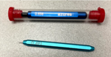
Distribution & Cgk
No obviously difference measurement result between Supplier and Garmin once measurement fixture and standard are aligning .
Measurement Site | Cgk
Supplier | 0.76
Garmin | 0.70
No obviously difference
Test Plan:
MSA
Check
Cgk
Check
F-Test / T-Test
Check

Slide 6
Statistically Different?
Notes:
透過檢查兩筆數據的變異數和平均值的差異，來確認兩者是否沒有顯著差異

Slide 7
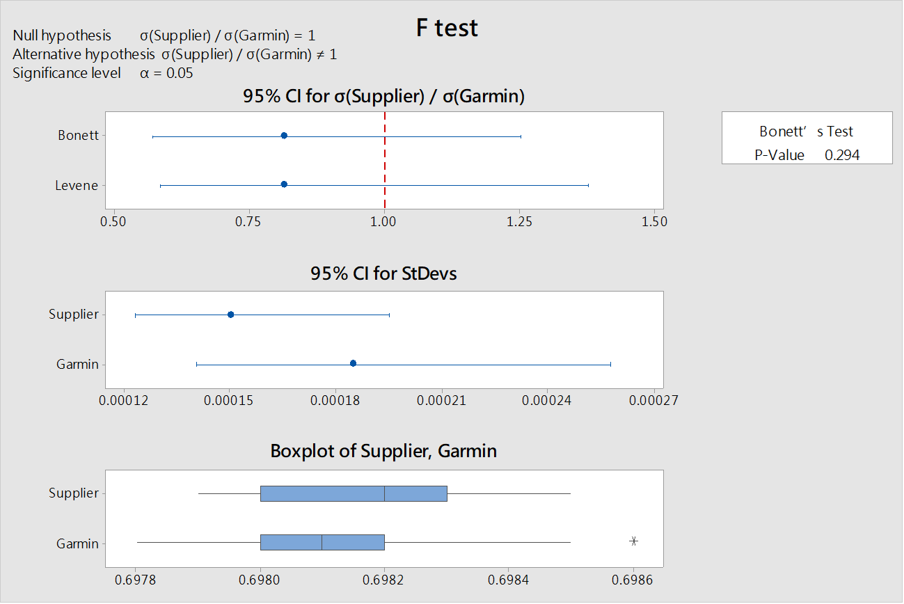
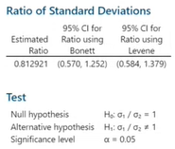
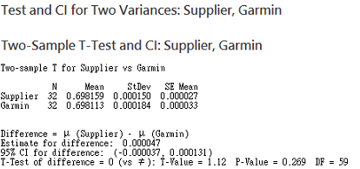
F-TEST & T-TEST Validation
No statistically significant difference is observed between supplier and Garmin site due to p-Value of F-Test and T-Test are both > 0.05 .
Hypothesis Test | p-Value
F test H0= σS / σG | 0.294 > 0.05
T test H0= µs - µG | 0.269 > 0.05
No significant difference
Test Plan:
MSA
Check
Cgk
Check
F-Test / T-Test
Check
Notes:
F-Test : 比較變異數是否有明顯差異
T-Test : 比較2者樣品的平均值是否有明顯差異
95%的信賴區間(CI)，公式是σS / σG ，因為區間有橫跨於1 ，所以兩者有可能相同
P > 0.05，接收H0，拒絕H1

Slide 8
Lesson Learnt Recap
According to D2~D4 of 8D to solve the difference of measurement data between Supplier and Garmin , use the method of Cgk to compare, and verify the variance and average difference for measurement tool at the same time.

Slide 9
APPENDIX

Slide 10
Cgk
No obvious difference is observed on Cgk between supplier (0.760) and Garmin (0.7) site.

Slide 11
HYPOTHESIS TEST
F test: p-Value > 0.05, indicating standard deviation have no significant difference between sites.
T test: p-Value > 0.05, indicating mean value have no significant difference between sites.

Slide 12
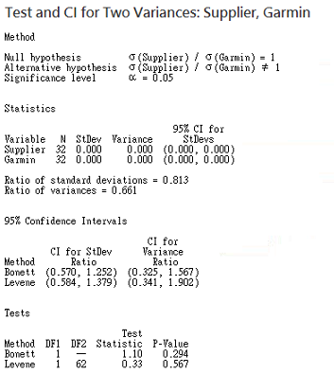
HYPOTHESIS TEST

Slide 13
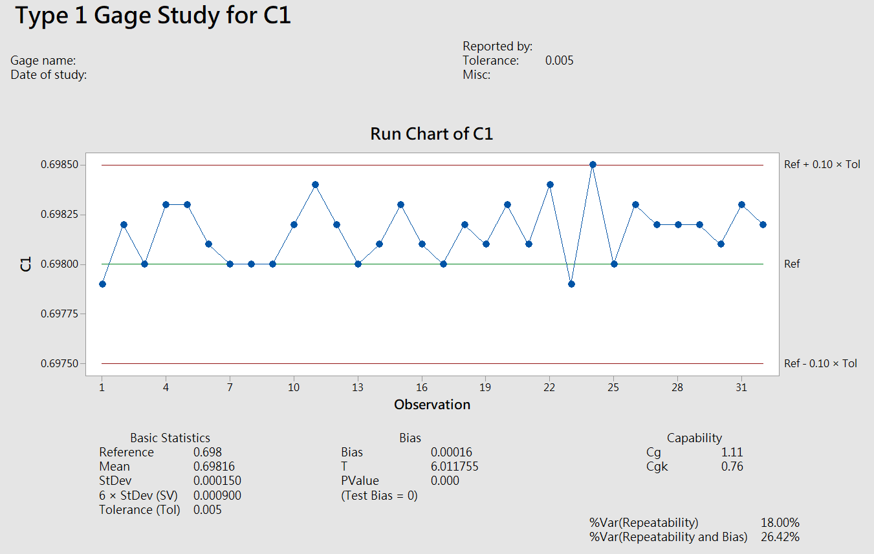
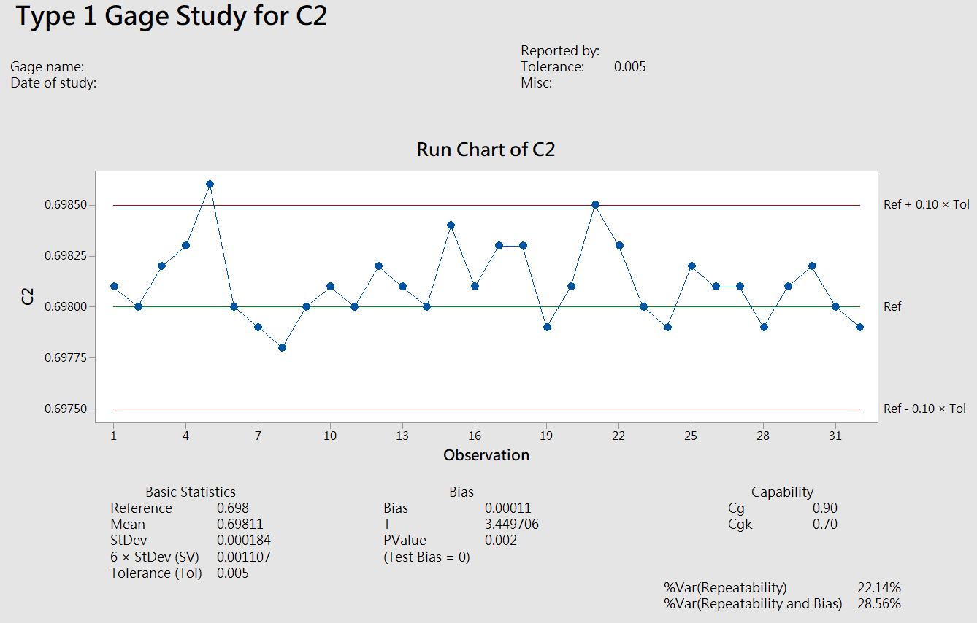
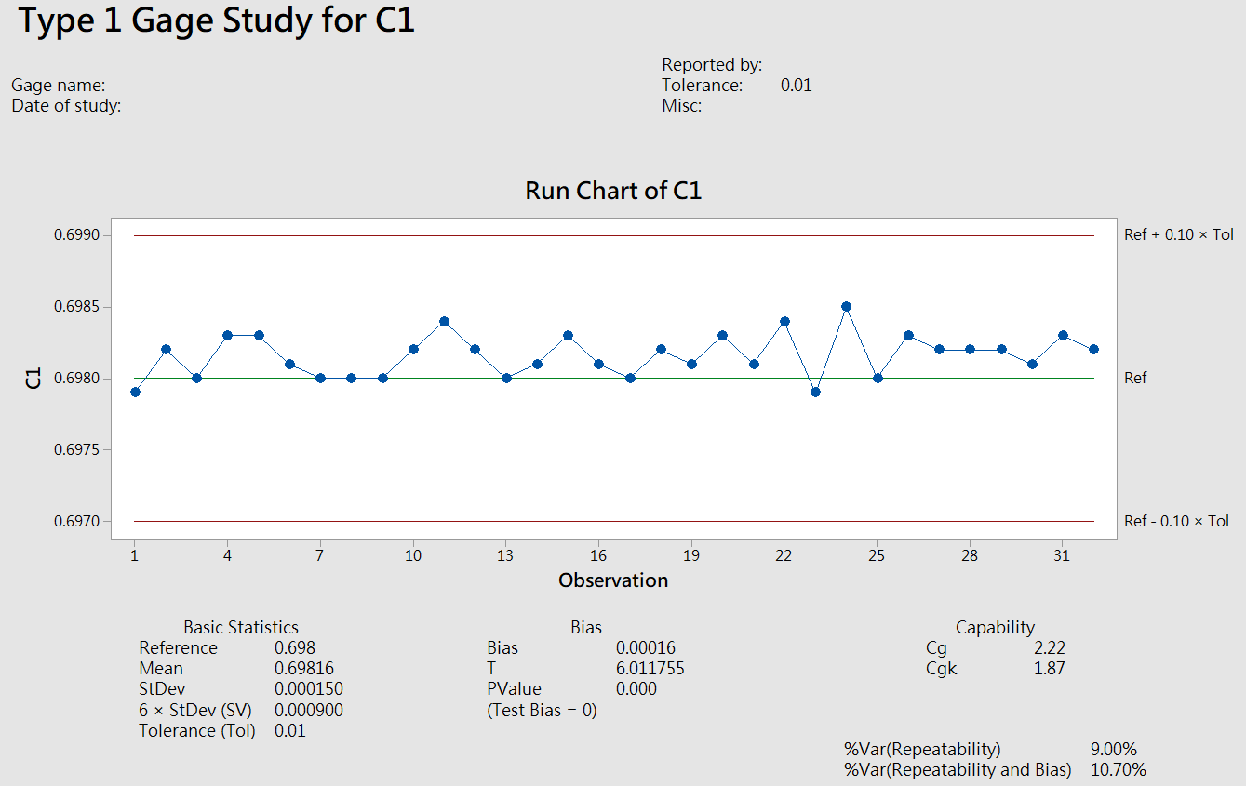
How to improve Cgk
Cgk of supplier and Garmin are < 1.33 due to the range is too small ( T -0.005).
We can improve the Cgk by raising range (T)
Measurement Site | Supplier | Garmin
Range | 0.005
Cgk | 0.76 | 0.7
Range | 0.01
Cgk | 1.87 | 1.6
Notes:
0.698 gauge(T-0.005)算出來Cgk=0.7, 不符1.33規格, 原因是T=0.005非常小
Cg是衡量量測的變異
Cgk是衡量量測的Target與Sigma的綜合指標

Slide 14
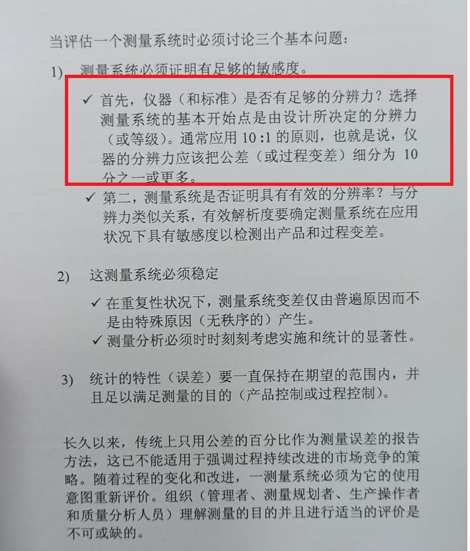
MSA Guideline

